Slide 1
Job Hub/Hunt Connect: Revolutionizing Job Search
~ Your Gateway to Diverse Opportunities
Sainithin Damaragidda
Pavan Kalyan Kudidala
Uday Kalyan Nuthalapati
Vishal Miyapuram
Abhishek Kotrike
Sai Venkata Nithyananda Reddy Gajjala
Shravani Kasula
Keerthi Lekkala Dilli

Slide 2
TABLE OF CONTENTS
1.
6.
Introduction
Website of JobHub
2.
7.
SDLC Overview
Future Enhancements
3.
Organizational Challenges
8.
Code Inspection Details
4.
9.
JobHub Overview
Implementation Details
5.
10.
Core Requirements
Conclusion

Slide 3


Project Description
JobHub is a revolutionary platform designed to redefine the job search experience by providing users with a centralized hub to explore diverse employment opportunities.
In today's competitive job market, organizations face numerous challenges in attracting and retaining top talent. These challenges include inefficiencies in the recruitment process, difficulty in reaching qualified candidates, and lack of a comprehensive platform for job seekers.
JobHub addresses these challenges by offering a user-friendly platform that streamlines the job search process, connects employers with qualified candidates, and provides valuable insights into job market trends.

Slide 4
Project Description
Develop a job board platform to simplify the job search process for job seekers
Key Features:
1) User registration and authentication
2) Job listing aggregation.
3) Comprehensive job search and filtering
4) Job application submission and Review.
5) Resume/CV management
6) Collection of additional candidate details
7) FAQ’s and Stats for applied Jobs.

Slide 5

Members Responsibilities
User Experience and Frontend Development:
Pavan Kalyan Kudidala: Handled the frontend development for job search and application submission; implemented the resume/CV management feature.
Abhishek Kotrike: Created the wireframes and UI components for the platform; contributed to the frontend development.
Vishal Miyapuram: Worked on the user manual and walkthrough documentation; assisted in the frontend development.

Slide 6

Backend Development and System Architecture:
Uday Kalyan Nuthalapati: Responsible for user authentication and management; developed the backend for additional details storage and review details.
Keerthi Lekkala Dilli: Managed the database design and optimization; supported the backend development tasks.
Shravani Kasula: Designed the UML diagrams for the system architecture; helped with the backend development.
Sai Venkata Nithyananda Reddy: Responsible for the database setup and integration; contributed to the backend implementation.
Testing and Documentation:
Sai Nithin Damaragidda: Designed and executed the test cases for the application; collaborated on the overall functionality document.

Slide 7
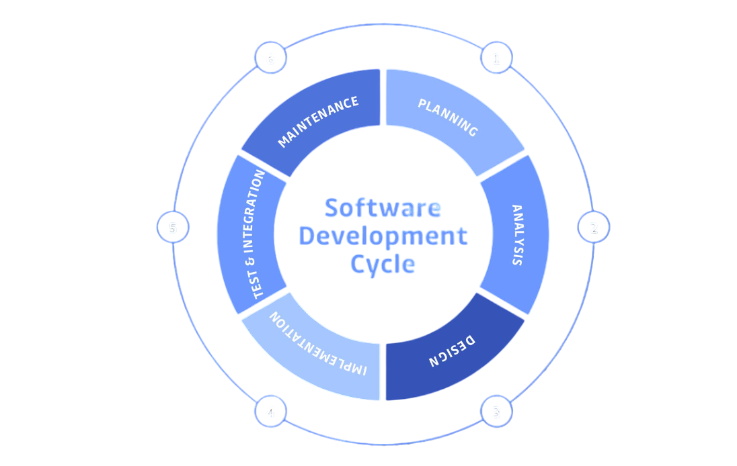
SDLC Overview
The Software Development Life Cycle (SDLC) for JobHub starts with planning, involving resource allocation and stakeholder consultations. This progresses into analyzing user and system requirements to shape detailed system specifications.
The design phase then establishes the architectural framework, using technologies like ReactJS setting the stage for the subsequent coding, testing, and deployment phases that ensure the platform’s functionality and scalability.

Slide 8

Organizational Challenges
Specific Challenges :
Recruitment Inefficiencies
Reaching Qualified Candidates
Lack of Comprehensive Platforms
Impact on Organization :
Reduced Productivity
Decreased Efficiency
Employee Dissatisfaction
Importance of JobHunt:
Streamlined Recruitment
Broader Reach to Qualified Candidates
Enhanced User Experience

Slide 9

JobHunt Overview
Aggregated Job Listings
User-Friendly Interface
Customized Experience
The JobHunt platform features an application tracking system that offers users detailed weekly and monthly statistics on their job applications, enabling effective monitoring and optimization of their job search strategies.
JobHub aggregates job listings, allowing users to easily browse and access a wide range of employment opportunities.
The platform offers a user-friendly interface that simplifies the job search process, making it easy for users to navigate and find relevant job listings.

Slide 10
Functionalities / Core Requirements
Upload Resume/CV
User Authentication and Management
Browse Job Listings
Job Application Submission
Job Hub FAQs
Search for Jobs by Keywords
Review and Edit Page
Apply for Jobs

Slide 11
User Authentication & Management: Facilitates secure user registration, login, and profile management, ensuring a personalized and secure experience.
Browse Job Listings : Allows users to access a comprehensive list of job opportunities aggregated from various sources.
Search for jobs by Keywords: Users can refine their job search using specific keywords, enhancing the relevancy of search results.
Apply for jobs: Simplifies the process of applying for jobs directly through the platform.
Upload resume: Enables users to upload and manage their resumes or CVs on their profiles for easy application submissions.

Slide 12
Job Application Submission: Supports the efficient submission of job applications through the platform.
Job Hub FAQs : Offers answers to common questions, helping users navigate and utilize the platform more effectively.
Review Page: Provides a final check where users can review and edit their details after applying.
Collect Additional Details: Gathers more comprehensive information from users during the application process to create detailed profiles.
Application Statistics Tracking: New functionality that tracks and displays statistics on jobs applied for over a specified period, such as the current month and week, helping users monitor their job search activity and plan accordingly.

Slide 13
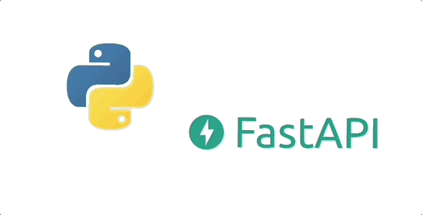


Implementation Details
Backend Technology: Python with FastAPI framework.
Frontend Technology: JavaScript (React.js) with Tailwind CSS
Deployment:
Backend: Hosted on Render
Frontend: Deployed on Netlify
Overall Structure: Three-tier architecture (Presentation, Application, Data)

Slide 14
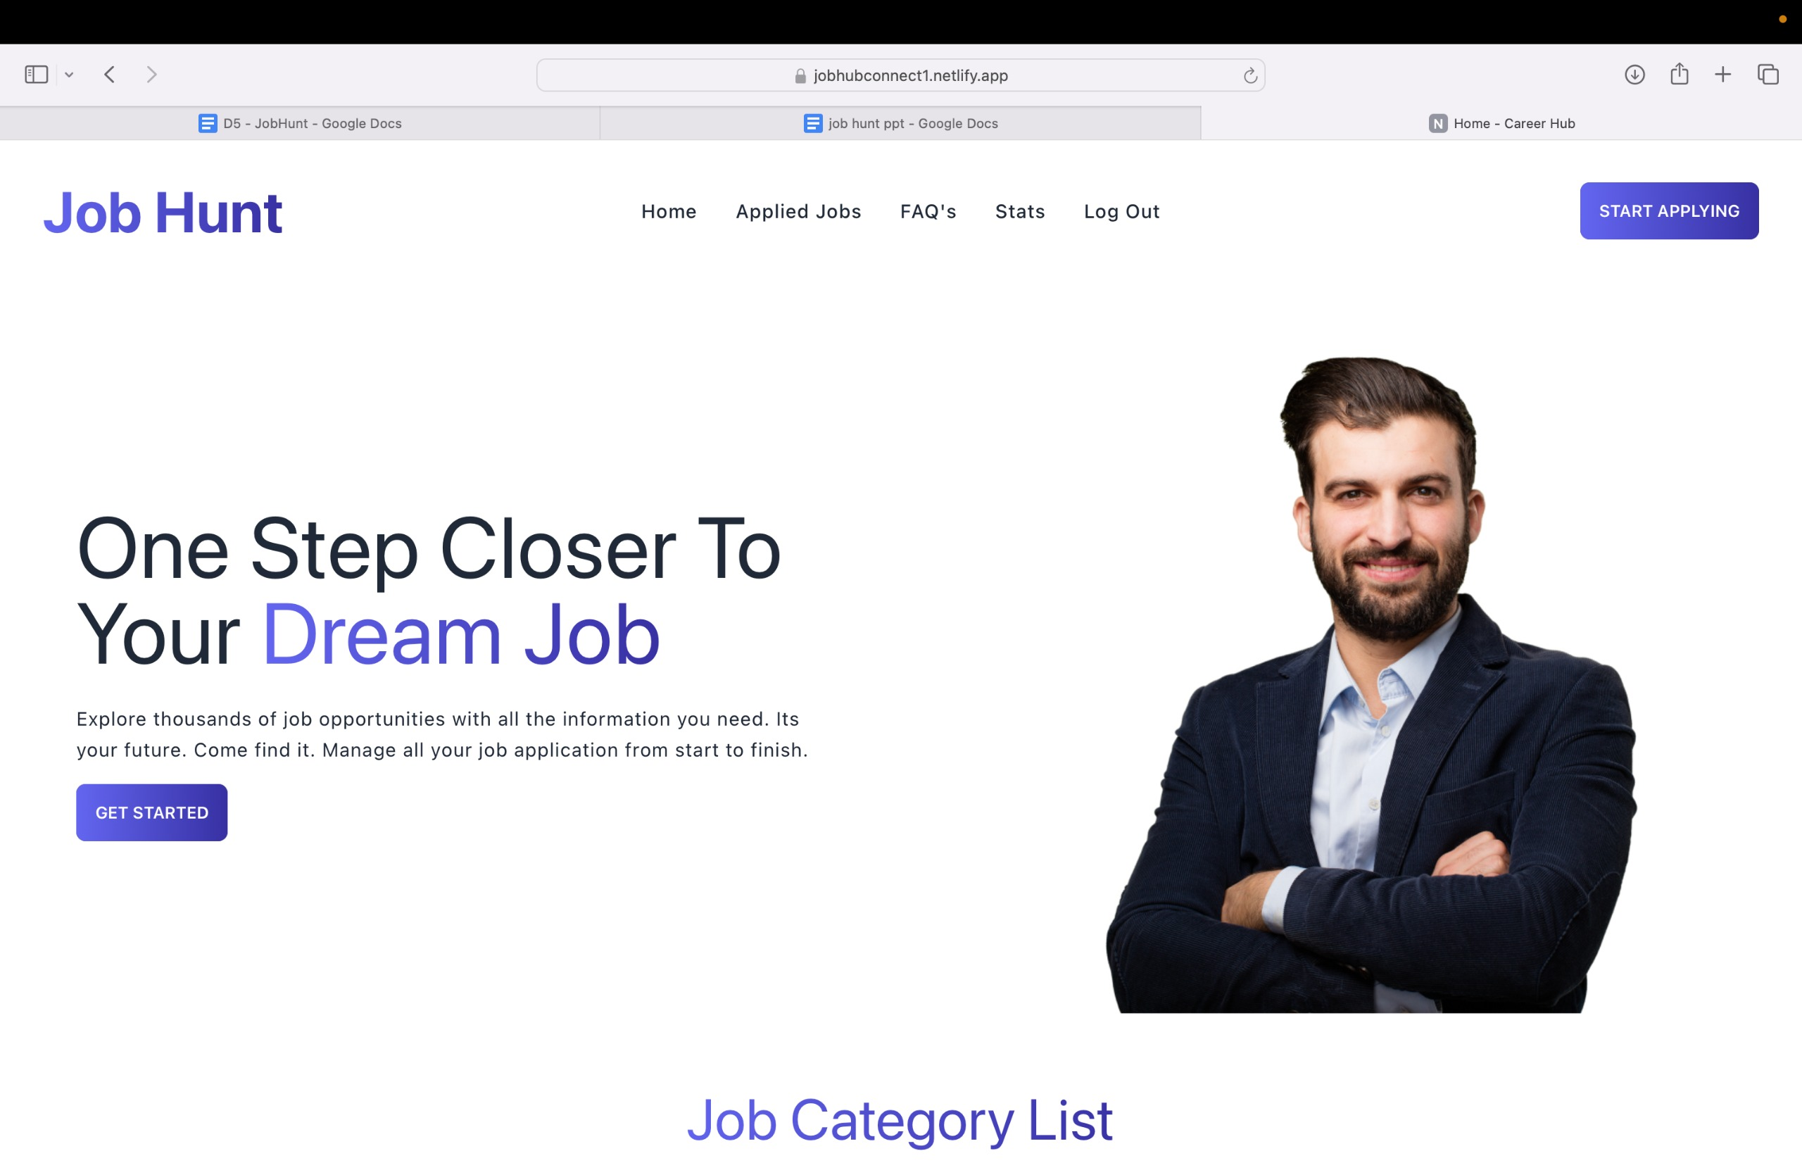
Website pages of JobHunt
Home Page: Central hub for quick access to features and recent job postings.

Slide 15
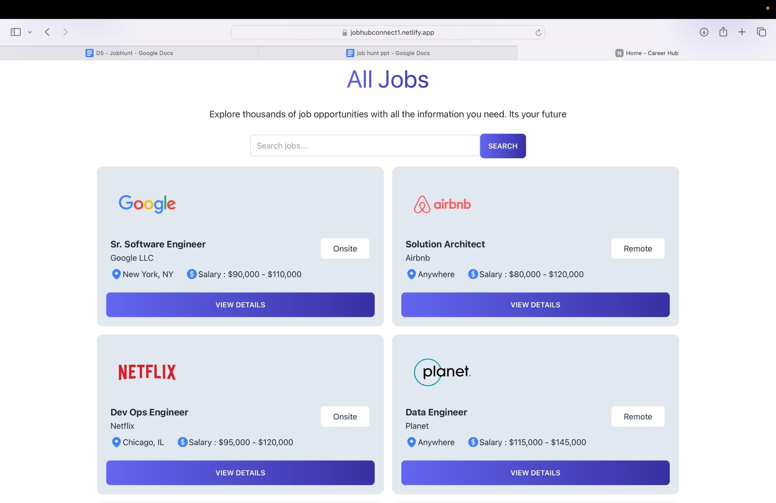
Website pages of JobHunt
Job Listings Page: Lists available jobs with robust filtering options.

Slide 16
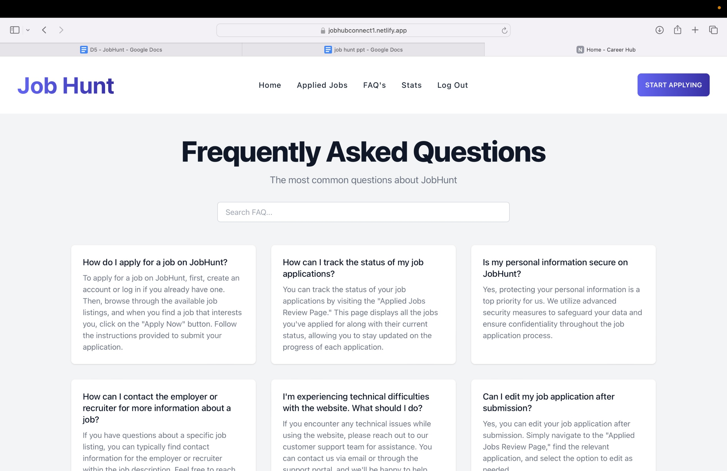
Website pages of JobHunt
FAQ Page: Answers common queries to assist users in navigating the platform.

Slide 17
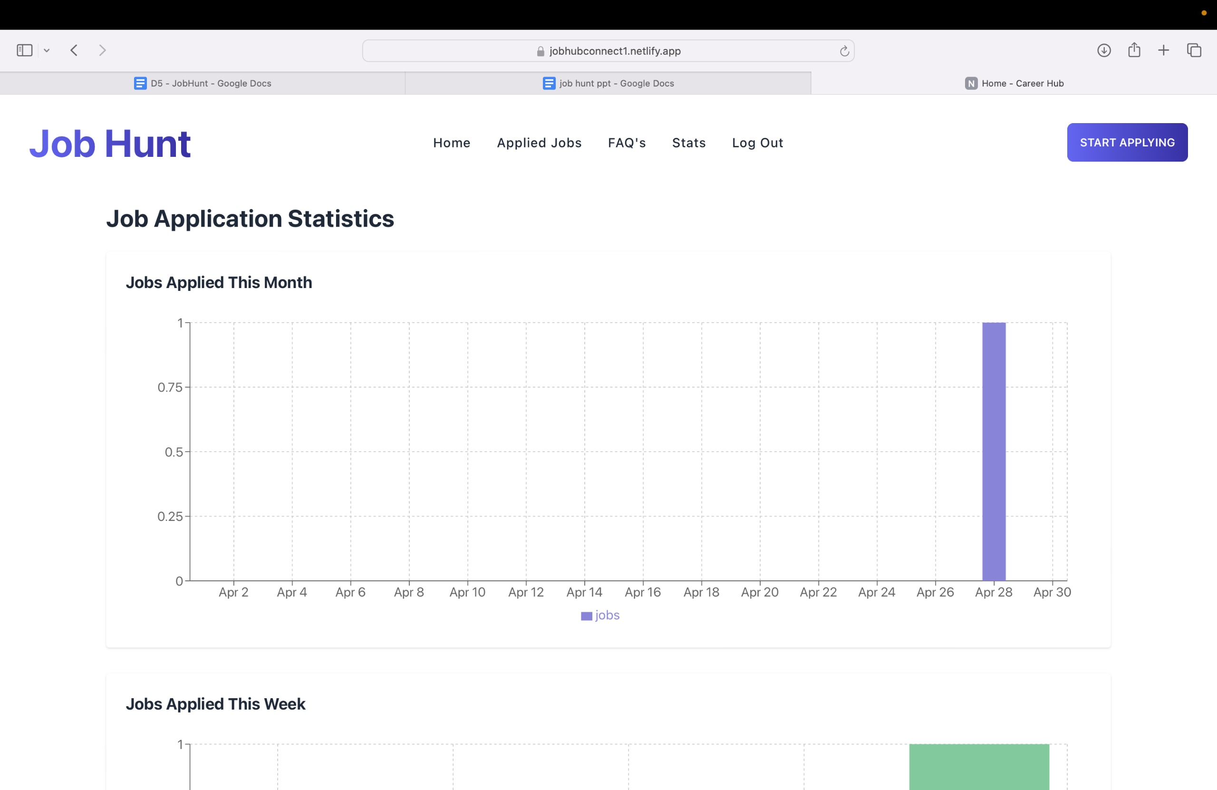
Website pages of JobHunt
Statistics Page: Displays how many jobs user applied on monthly and weekly basis.

Slide 18
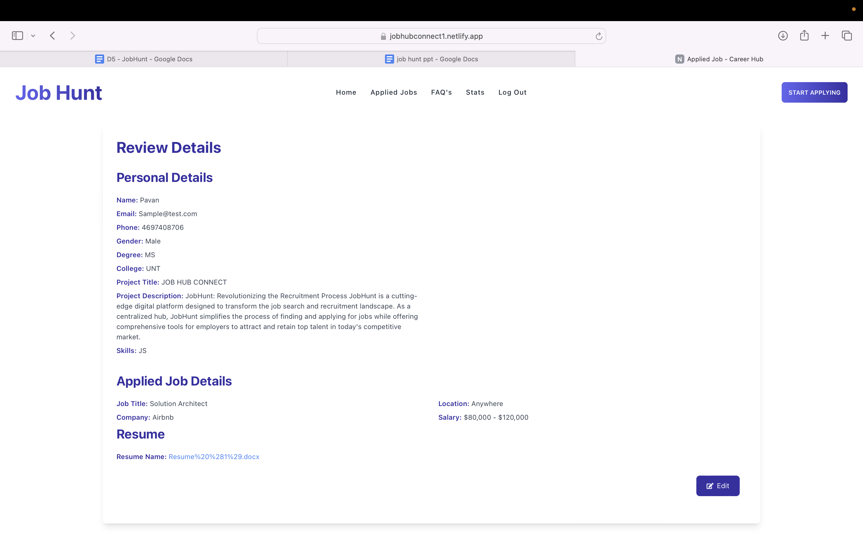
Website pages of JobHunt
Review Details Page: Allows users to see what they have and able to edit it.

Slide 19
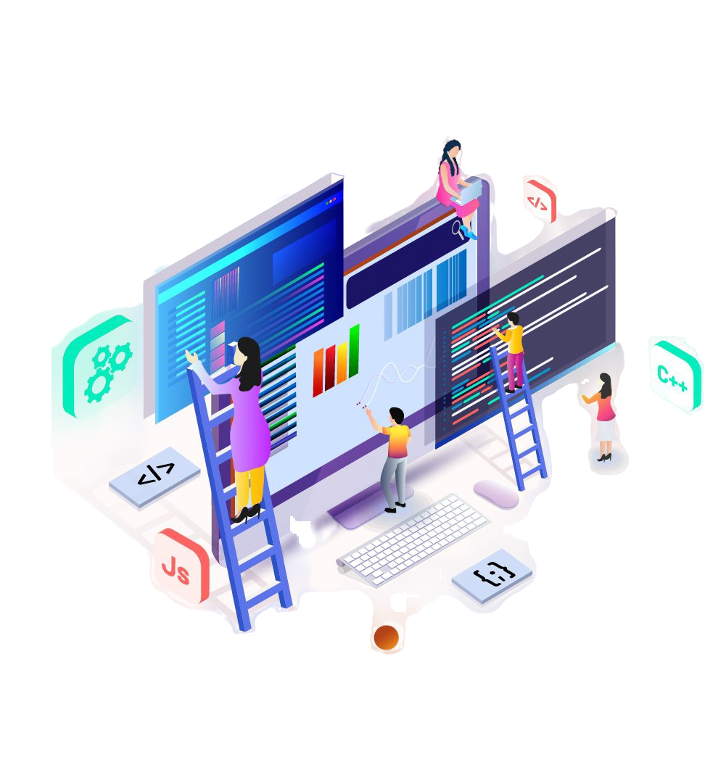
TESTING
Unit Testing:
Utilized Jest frameworks
Focused on testing individual components and modules
Achieved high code coverage for critical functionalities
Functional Testing:
Defined and executed test cases for user registration, job search, application submission, and other key features
Validated end-to-end user workflows and expected outcomes

Slide 20
Testing Experiences
Thorough unit testing helped identify and fix issues early in the development process, ensuring the reliability of individual components.
Comprehensive functional testing allowed the team to validate the overall system behavior and identify any gaps or inconsistencies in the application's workflows.
The testing approach enabled the team to deliver a high-quality product that met the requirements and expectations of the target audience.
Continuous integration and automated testing practices helped maintain code quality and catch regressions during the development lifecycle.

Slide 21

Feedback & Improvements
Peer Review Feedback:
Suggested integrating the backend functionalities directly into the main.py file
Recommended fully leveraging the Firebase database for data storage and retrieval
Provided recommendations for enhancing the documentation
Implemented the recommended changes to address the identified issues

Slide 22

Code Inspection Results
Identified issues with error handling and input validation
Provided suggestions for improving code readability and maintainability
Implemented the recommended changes to address the identified issues

Slide 23

Limitations & Challenges
API Integration Constraints:
The initial plan to aggregate job listings from multiple external sources was limited by API availability and access restrictions
Worked around this by focusing on a curated set of job listings initially
Integration Complexities:
Integrating the frontend and backend components posed some challenges due to data format inconsistencies
Addressed these issues through thorough testing and iterative refinement of the integration processes
Resource and Time Constraints:
Limited resources and time frame resulted in the need to prioritize core functionalities over additional features
Certain planned features, such as community engagement and advanced reporting, had to be deferred to future phases

Slide 24

Conclusion
The JobHub Connect platform successfully met its objectives by providing job seekers with a comprehensive platform for job search, application management, and data insights.
The platform's robust features, secure data management, and responsive design have been well-received by the target audience.
Future Enhancements:
- Explore community engagement features
- Implement personalized job recommendations
- Integrate an employer portal
- Enhance reporting and analytics capabilities
- Optimize the mobile-friendly user experience

Slide 25

Thank You
Group-9

